Slide 2
CVRP Capacitated Vehicle Routing Problem
Group 14
Madalena Sampaio 93294
Maria Cardoso 93661
João Rosado 96409

Slide 3
CVRP – Capacitated Vehicle Routing Problem
Classic optimization problem in logistics and operations research
Determining the most efficient routes for a fleet of vehicles to deliver goods to a set of destinations
Capacity constraints on each vehicle
Each route visits a subset of nodes and starts and terminates at the depot

Slide 4
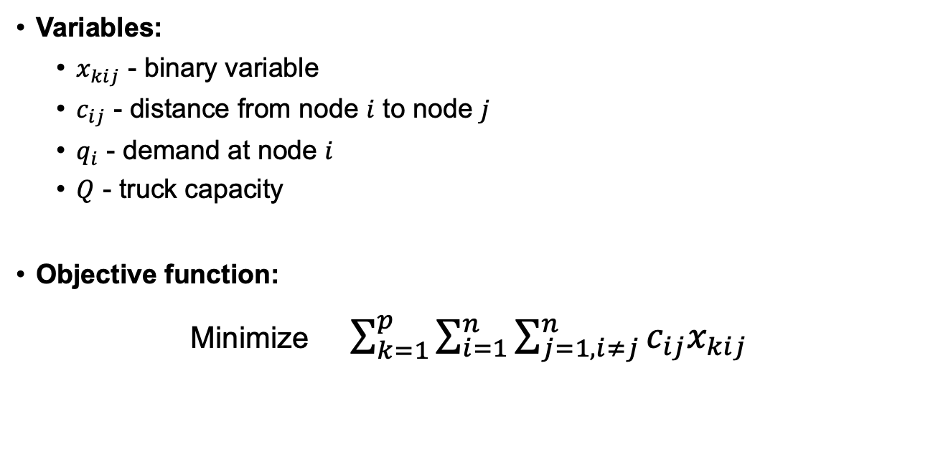
Defining the Problem
Variables:
$x_{kij}$ - binary variable
$c_{ij}$ - distance from node $i$ to node $j$
$q_{i}$ - demand at node $i$
$Q$ - truck capacity
Objective function:
Minimize $\sum_{k=1}^{p}{\sum_{i=1}^{n}{\sum_{j=1, i≠j}^{n}{c_{ij}x_{kij}}}}$

Slide 5
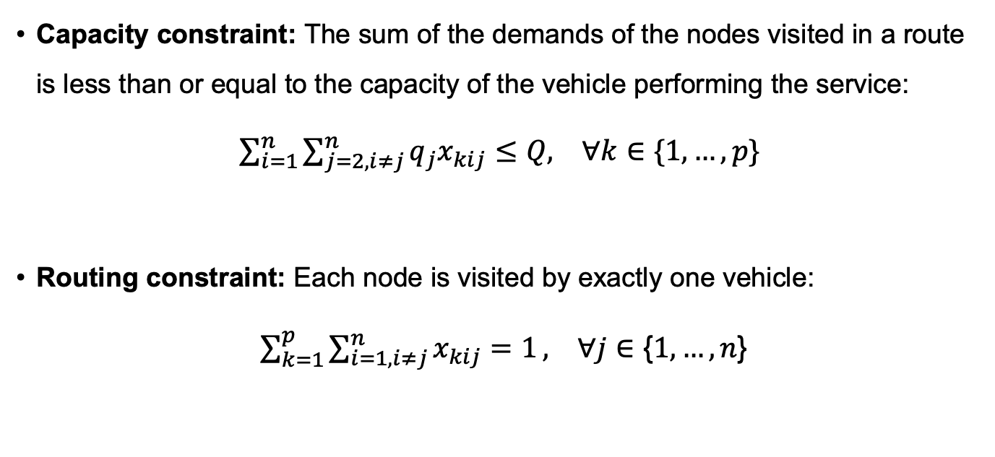
Constraints
Capacity constraint: The sum of the demands of the nodes visited in a route is less than or equal to the capacity of the vehicle performing the service:
$\sum_{i=1}^{n}{\sum_{j=2,i≠j}^{n}{q_{j}x_{kij}≤Q, ∀k∈\text{\{}1, …, p\text{\}}}}$
Routing constraint: Each node is visited by exactly one vehicle:
$\sum_{k=1}^{p}{\sum_{i=1,i≠j}^{n}{x_{kij}=1}}, ∀j∈\text{\{}1, …, n\text{\}}$

Slide 6
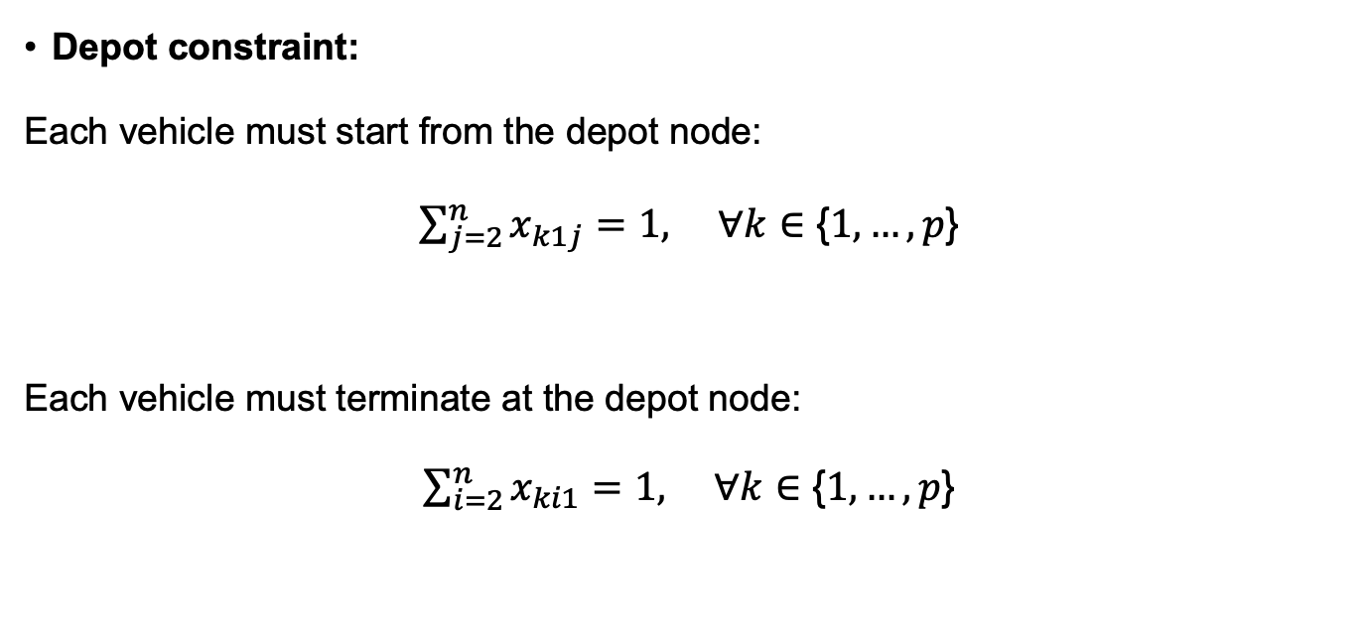
Constraints
Depot constraint:
Each vehicle must start from the depot node:
$\sum_{j=2}^{n}{x_{k1j}=1, ∀k∈\text{\{}1, …, p\text{\}}}$
Each vehicle must terminate at the depot node:
$\sum_{i=2}^{n}{x_{ki1}=1, ∀k∈\text{\{}1, …, p\text{\}}}$

Slide 7
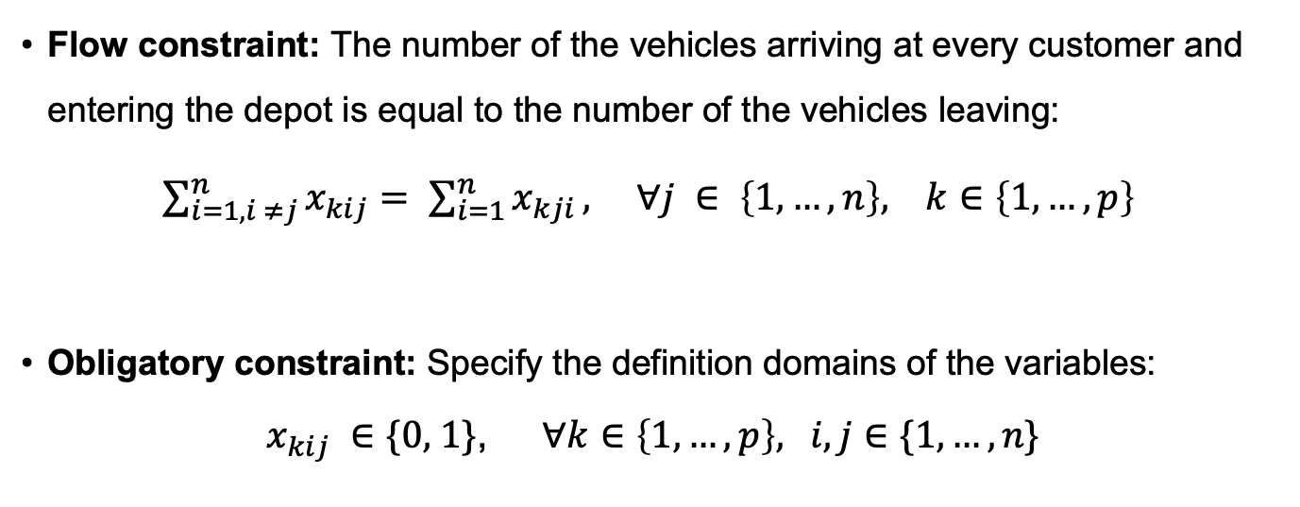
Constraints
Flow constraint: The number of the vehicles arriving at every customer and entering the depot is equal to the number of the vehicles leaving:
$\sum_{i=1, i ≠j}^{n}{x_{kij}}= \sum_{i=1}^{n}{x_{kji}}, ∀j ∈ \left\{1, …, n\right\}, k∈\left\{1, …, p\right\}$
Obligatory constraint: Specify the definition domains of the variables:
$$x_{kij} ∈\text{\{}\text{0, 1}\text{\}}\text{, }∀k∈\left\{1, …, p\right\}\text{,} i,j∈\text{\{}1, …, n\text{\}}$$

Slide 8
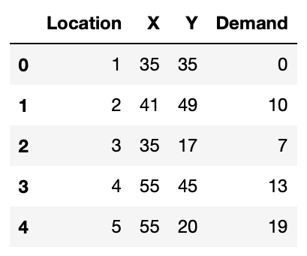

Programming
Import Datasets
2 datasets:
50 nodes + depot, $Q=160$
100 nodes + depot, $Q=200$
Each file displays:
Each node's coordinates
Each node's demand
Each truck's capacity

Slide 9
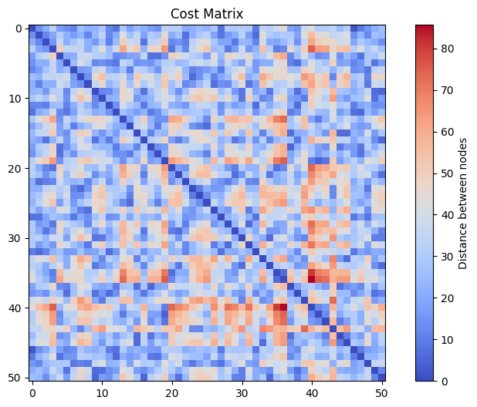
Programming
Defining the cost matrix
Each entry of the matrix displays the euclidean distance between two nodes

Slide 10
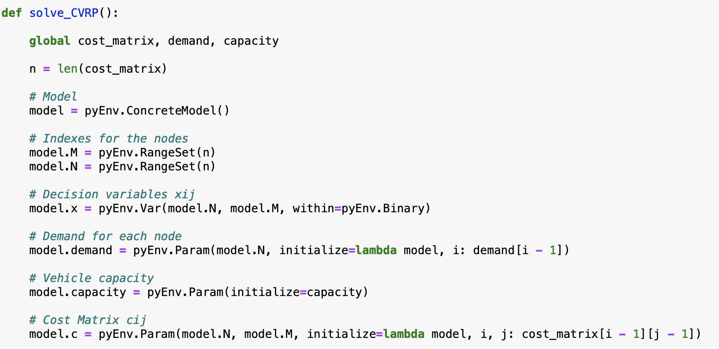
Programming
Defining the Solver

Slide 11
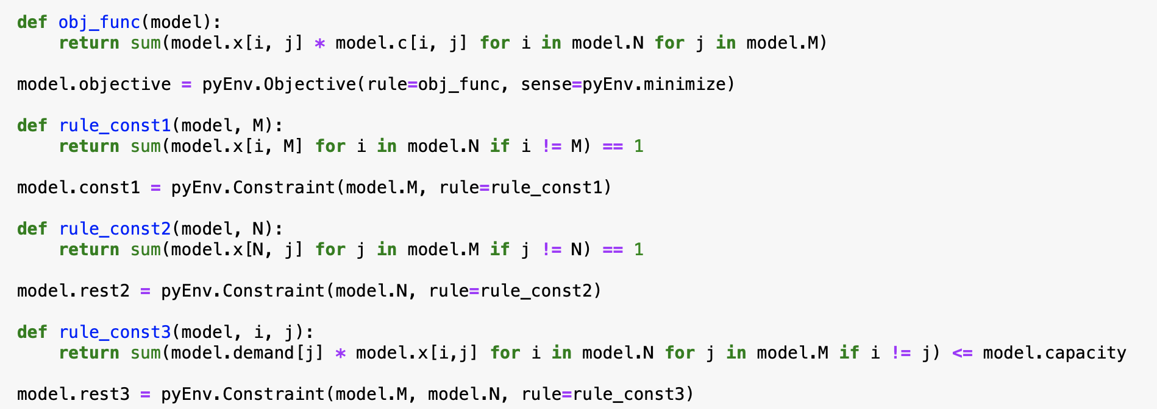
Programming
Defining the Solver

